Slide 1

SAVEETHA ENGINEERING COLLEGE, CHENNAI
Intelligent Crop Disease Monitoring & Management
Presented by
Dr.C.Anna Palagan
Professor, SCOFT/ECE
07-01-2025

Slide 2

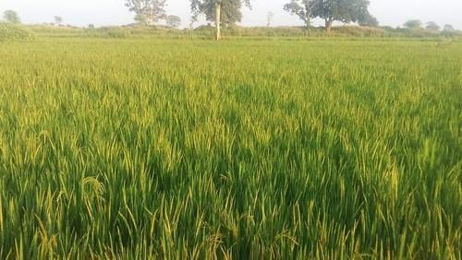
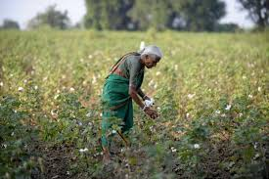
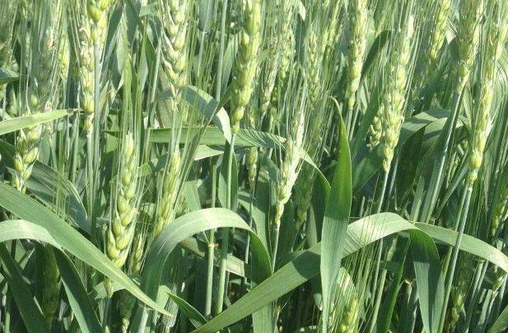
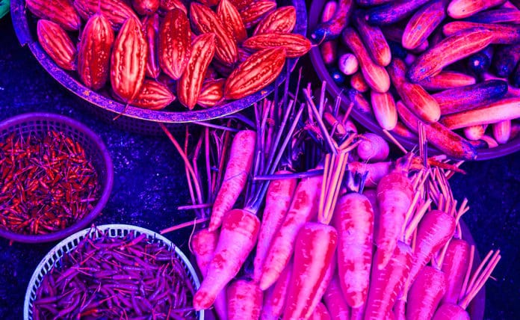

Soil Testing-Partially done in few land.
Due to improper soil testing the Farmers get less yield.
During growth of the crop, the diseases are not identified properly.
Nutrient deficiency and toxicity in the soil lead to diseased crops.
Diseases identification done by manually, so most of the times finding is difficult.
Spraying Fertilizers in the pest and disease affected zones also done manually by farmers, it takes more time and not secured for the Farmers.
Present AGRICULTURE SYSTEM

Slide 3
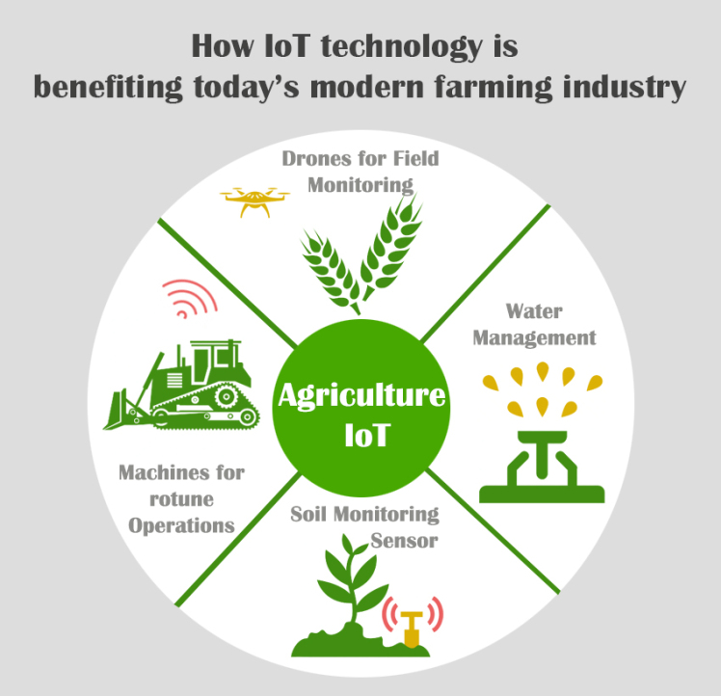

Objectives of the project.
Identification of damages and diseases of crops by Image-based insight generation.
Optimization of Disease recognition and growth condition for the better result.
To analyze the Agricultural field with farmers.
To develop different Crop preparation recognizable for getting much more yields.
To evaluate the techniques going to adopt and better utilization as a smart agricultural system
After standardization and evaluation of the system, finally training can be imparted to farmers to empower them and other interested sectors to utilize this technology
To develop an Artificial Intelligence System by using the parameters taken from IoT.

Slide 4
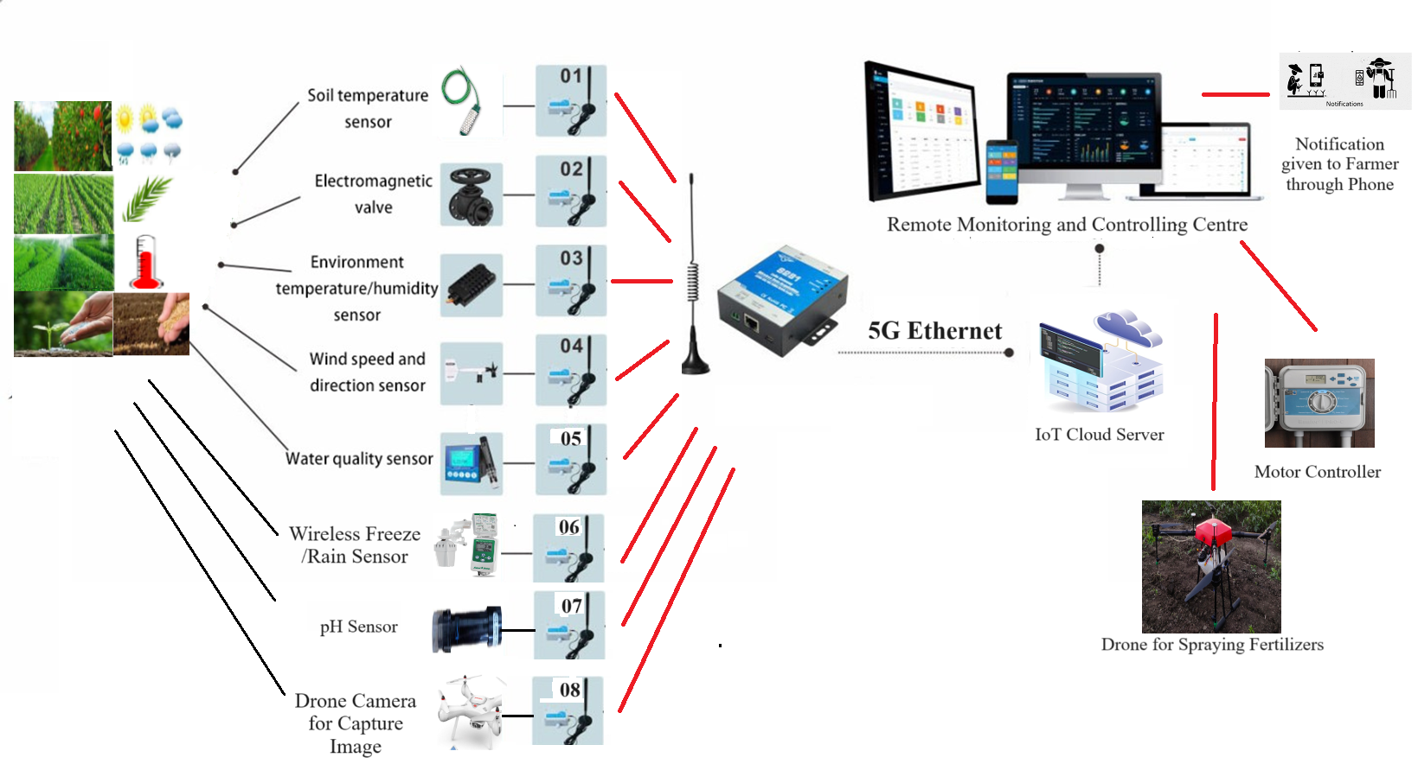
Proposed Method

Slide 5
Important Components Used
Type of Sensors | Specification
Pressure Sensor | M3021-000002-070BG
Ultrasonic Sensor | HC-SR04
Watermark Soil Moisture Sensor | Irrometer 200SS-5
PH Sensor Module for Arduino | Robocraze
Material Moisture Meter | Testo 606-1
Zone Base Controller | Hunter Pro-C PC-400 4
Automatic Soil Moisture Controller With Sensor | Tanishka Digital Control
Wireless Rain/Freeze Sensors | WR2 & WR2-48 Series
Ultrasonic Wind Sensor | WindSonic
Soil Moisture Meter | FieldScout TDR 150
Drone for Spraying | Phoenix 4 AG 10L Drone
Drone for Capture Plant Image | Syma X25Pro RC Drone with Adjustable Wi-Fi 720P HD Camera, GPS Return Home, Altitude Hold, Follow Me RC Quadcopter

Slide 6
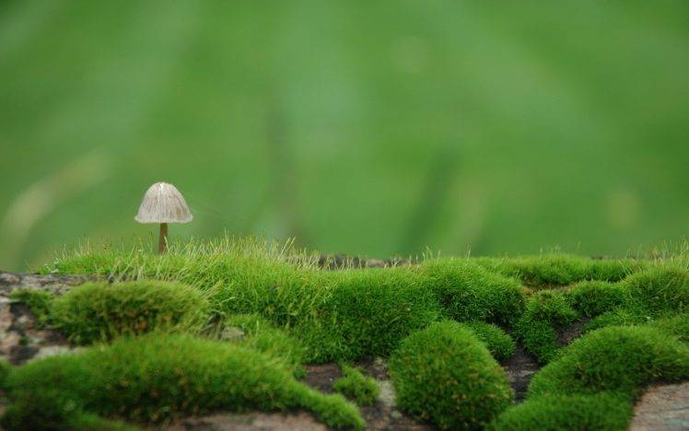

Soil Testing
Soil taken from 5 places from each Acres
Apply Micro and Macro Nutrient Testing.
Composting
Blue River Technology for weed management
Automatic Fertilizer Dosing Control
Ecofriendly
Completely organic
Fertilizers in the pest and disease affected zones only
Tracking of plant growth
Plant Growth is monitored by AI Network
Solutions for each changes will be updated
Benefits to the target
Farmer’s entrepreneurs will be trained and supported
Trained beneficiaries get more revenue

Slide 7

Workplan
Sl. No. | Milestone | I Year (months) |  |  |  | II Year (months) |  |  |  | III Year (months)
 |  | 1-3 | 4-6 | 7-9 | 10-12 | 1-3 | 4-6 | 7-9 | 10-12 | 1-3 | 4-6 | 7-9 | 10-12
1. | Investigation of Smart Agriculture systems and Literature survey
2. | Testing using Advanced Image Processing and AI techniques
3. | Implementation using Advanced Image Processing and AI techniques
4. | Conduction of Workshop and Training for Farmers
5. | Combining different techniques and comparisons
6. | Develop a prototype model for the Smart Agriculture system using advanced AI algorithm and patent registration
7. | Project Documentation & Presentation
8. | End of Project

Slide 8
BUDGET ESTIMATES: SUMMARY
S.No | Item | BUDGET
 |  | 1st Year | 2nd Year | 3rd Year | Total
Recurring
1. | Salaries/Wages | Rs.72000/- | Rs.84000/- | Rs.108000/- | Rs.264000/-
2. | Consumables | Rs.55000/- | Rs.25000/- | Rs.20000/- | Rs.100000/-
3. | Travel | Rs.115000/- | Rs.115000/- | Rs.120000/- | Rs.350000/-
4. | Training Programme | Rs.40000/- | Rs.40000/- | Rs.40000/- | Rs.120000/-
5. | Contingency | Rs.35000/- | Rs.25000/- | Rs.30000/- | Rs.90000/-
6. | Overheads | Rs.35000/- | Rs.25000/- | Rs.30000/- | Rs.90000/-
B. Non-Recurring
7. | Equipment | Rs.1680000/- | Rs.10000/- | Rs.10000/- | Rs.1700000/-
8. | Fabrication Costs | Rs.1500000/- | Rs.0/- | Rs.0/- | Rs.1500000/-
 | Total (B) | Rs.3180000/- | Rs.10000/- | Rs.10000/- | Rs.3200000/-
 | Grand Total (A+B) | Rs.3512000/- | Rs.314000/- | Rs.348000/- | Rs.4214000/-

Slide 9

Maybe we can look forward to a day where we can just toss our Agriculture System in the yard as a Revenue for the Farmers, without Death due to Low Price of Yields.
Let’s hope that time comes sooner rather than later and let it be Made in India.
THANK YOU

